Slide 1
Ch.1 Probability (확률)
Updated: September 11th, 2016
Choi, Kwanghoon
Dept. of Electronics and Computer Engineering
Chonnam National University

Slide 2
This Lecture
Probability
Sample space and events
Two definitions of probability
Conditional probability

Slide 3
1.1 Events (사건)
Activity1: Write down all outcomes from the toss of a coin three times.

Slide 4
1.1 Events (사건)
Activity2: In the toss of a coin three times,
enumerate all outcomes where a head comes up at least two times and also
enumerate all outcomes in which a tail appears at least once.

Slide 5
1.1 Events (사건)
Preliminaries to define probability
The sample space(표본공간): S
A set of all outcomes in a statistical experiment
Events(사건): A, B, C, …
A subset of the sample space
Ref. A-1 Set(집합)
cf. A-1 => Appendix (부록) A장 1절

Slide 6
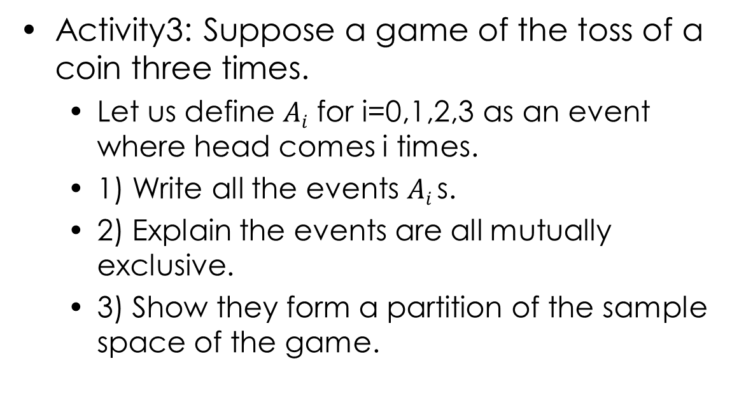
1.1 Events (사건)
Activity3: Suppose a game of the toss of a coin three times.
Let us define $Ai$ for i=0,1,2,3 as an event where head comes i times.
1) Write all the events $Ai$s.
2) Explain the events are all mutually exclusive.
3) Show they form a partition of the sample space of the game.

Slide 7
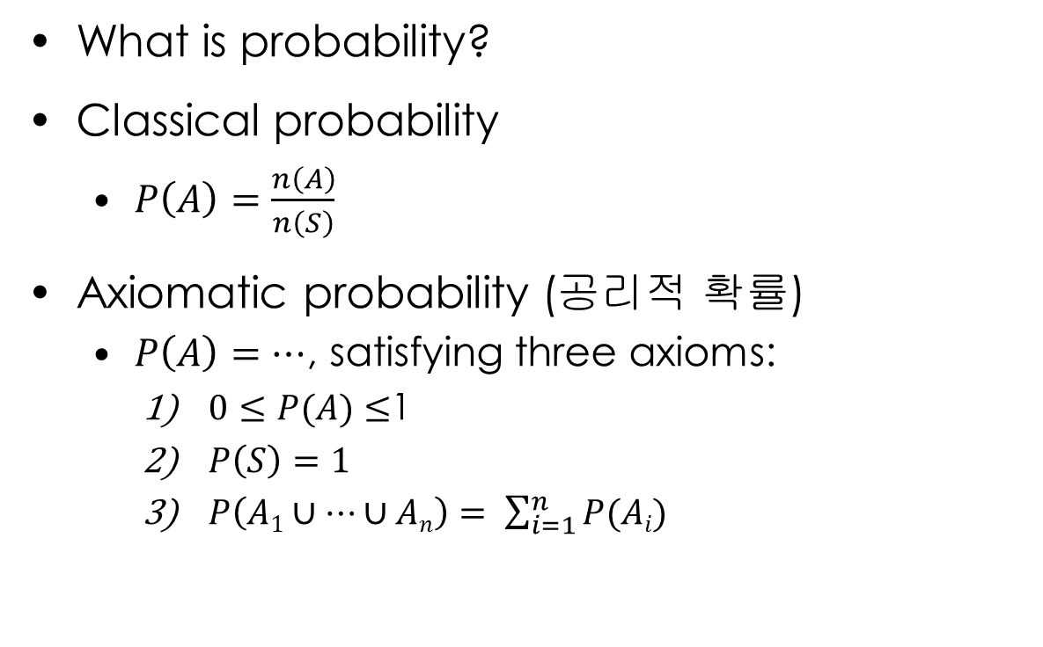
1.2 Probability (확률)
What is probability?
Classical probability
$P\left(A\right)=\frac{n\left(A\right)}{n\left(S\right)}$
Axiomatic probability (공리적 확률)
$P\left(A\right)=…$, satisfying three axioms:
$0≤P(A)≤$1
$P\left(S\right)=1$
$P\left(A1∪…∪An\right)= \sum_{i=1}^{n}{P(Ai)}$
cf. n(Set) denotes the number of elements in the set.
cf. All $Ai$s are mutually exclusive(쌍마다 배반) events with another.

Slide 8

1.2 Probability (확률)
Activity4
According to the classical probability, calculate the probabilities of the events $Ai$ in Activity 3.

Slide 9
1.2 Probability (확률)
Activity5
Read 예제5 and its solution. Explain the difference between the two definitions of probability, or explain why the axiomatic probability is introduced besides the classical probability.

Slide 10
1.3 Conditional Probability (조건부 확률)
Activity 6 (1/2)
Assume a game of the roll of a die twice.
A is an event that the 1st number is five.
B is an event that the 2nd one is even(짝수).
Calculate the event A.
Assuming that the event A has occurred, calculate the event B.
Then compute the probability of the event B conditional on the event A.

Slide 11

1.3 Conditional Probability (조건부 확률)
Activity 6 (2/2)
Calculate the event B under no condition.
Compute a relative ratio of $A∩B$ to $A$, which is the probability of the event B conditional on the event A.

Slide 12

1.3 Conditional Probability (조건부 확률)
The probability that event B occurs conditional on event A having occurred
$P(B|A) =P(A∩B)/P(A)$
S
A
A∩B
B

Slide 13

1.3 Conditional Probability (조건부 확률)
Event A and B are independent events if
$P\left(B | A\right)=P\left(B\right)$
( equivalently, $P\left(A∩B\right)=P\left(A\right)P\left(B\right)$ )

Slide 14






1.3 Conditional Probability (조건부 확률)
A radar system watching a sector of the sky if any airplane is flying up there.
$P\left(B|A\right)=0.9$9
$$P\left(A\right)=0.05$$
$$P\left(B^{C}|A\right)=0.01$$
$$P\left(A^{C}\right)=0.95$$
$P\left(B|A^{C}\right)=0.$1
$P\left(B^{C}|A^{C}\right)=0.$9
Event A: a plane is flying out there.
Event B: the radar system sounds a warning alarm.

Slide 15

1.3 Conditional Probability (조건부 확률)
Calculate the following probabilities over the radar system:
$P\left(A∩B\right)=$
$P\left(B\right)=$
$P\left(A | B\right)=$

Slide 16
1.3 Conditional Probability (조건부 확률)
Three useful techniques based on conditional probability to calculate probabilities
Multiplication law (곱의 법칙, 교재 P.26)
Total probability formula (전확률 공식, 교재 P.31)
Bayes’ theorem (베이즈 정리, 교재 P.32)

Slide 17
What we have learned
Basics of Probability
Sample space and events in probability
Axiomatic probability
Conditional probability and the notion of independence of two events

